Slide 1
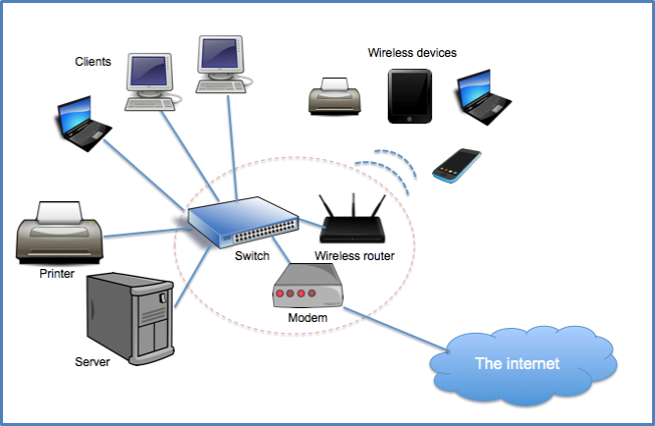
Computer Network Interconnecting of Devices in order to share Resources

Slide 2
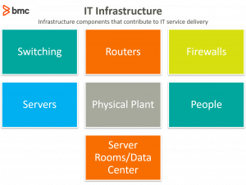

Slide 3
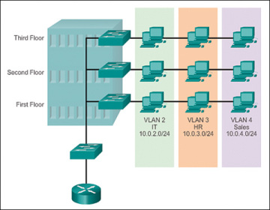
Switching
Switches are used to connect multiple devices on the same network within a campus.
Allowing the various devices to share information and talk to each other.
The switch makes its forwarding decisions based only on the Layer 2 Ethernet MAC addresses.

Slide 4
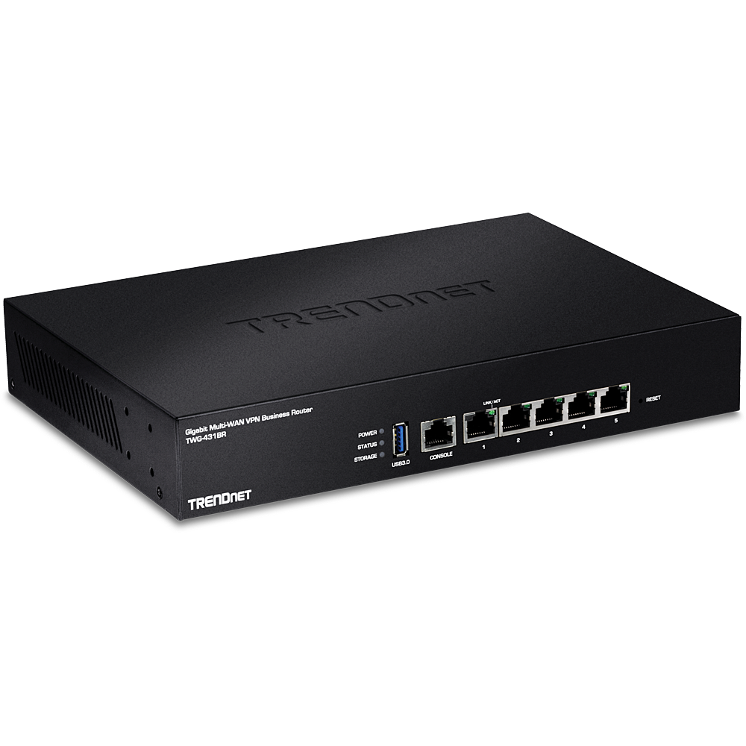
ROUTER
It is a Network layer device.
Used to connect different networks
Does Packet Filtering.
Finds Best path .

Slide 5
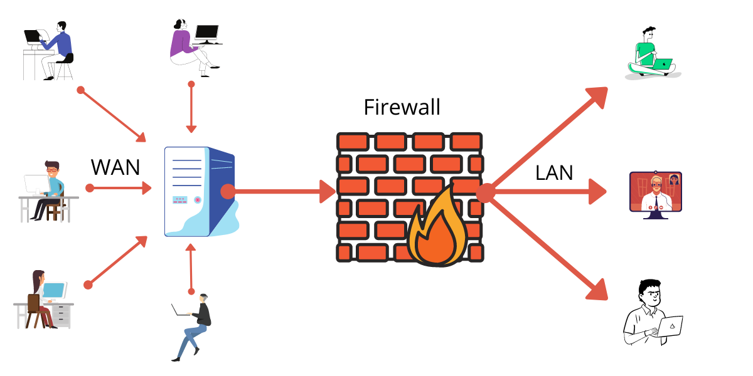
FIREWALL
Firewall is a security software or hardware that can monitor and control network traffic, both incoming and outgoing
Capable of preventing unauthorized access to/from private networks.

Slide 6
DATA CENTRES
Data centre is simply a facility that a business uses to house its IT equipment.
Power supply and distribution
Uninterruptable power supplies (UPS) for reliability
Stand-by generators for use in the case of a mains power failure
Ventilation and cooling for the IT equipment
Fire detection and suppression systems
Physical security and access control
Network connectivity to the outside world
Compute: The memory and processing power to run the applications, generally provided by high-end servers
Storage: Important enterprise data is generally housed in a data center, on media ranging from tape to solid-state drives, with multiple backups
Networking: Interconnections between data center components and to the outside world, including routers, switches, application-delivery controllers, and more

Slide 7
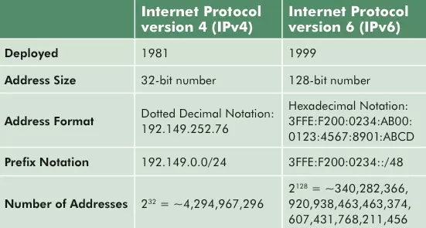
IP ADDRESSING

Slide 8
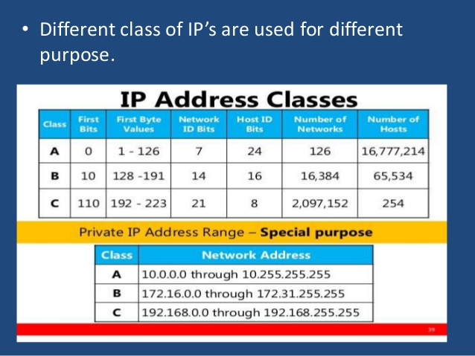
IP ADDRESSING

Slide 9
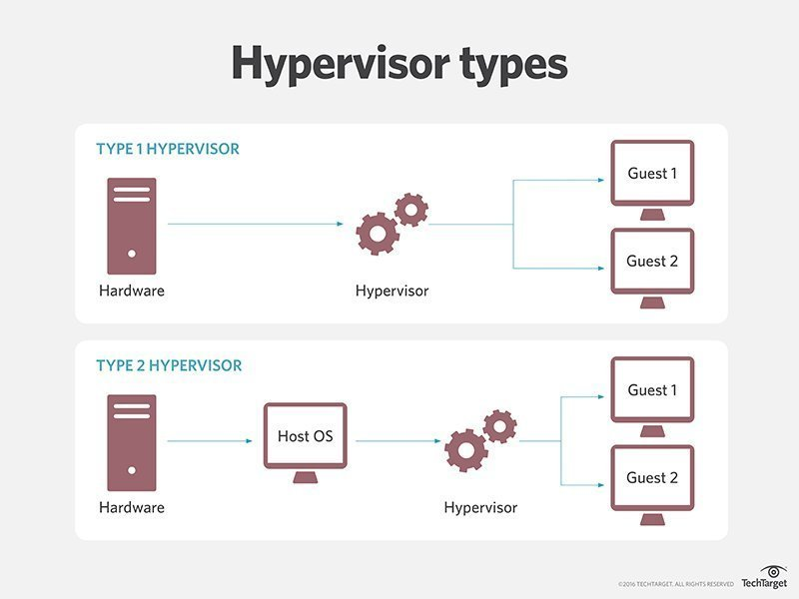
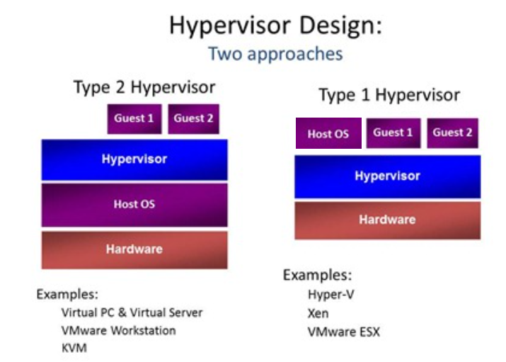
Virtualization

Slide 10

What Is Cloud Computing?
Cloud computing is a type of Internet-based computing that provides shared computer processing resources and data to computers and other devices on demand. It is a model for enabling ubiquitous, on-demand access to a shared pool of configurable computing resources (e.g., computer networks, servers, storage, applications and services), which can be rapidly provisioned and released with minimal management effort.

Slide 11
characteristics of Cloud Computing
1. RESOURCES POOLING
2. ON-DEMAND SELF-SERVICE
3. EASY MAINTENANCE
4. SCALABILITY AND RAPID ELASTICITY
5.MEASURED AND REPORTING SERVICE
6. SECURITY
7. AUTOMATION
8. RESILIENCE
9. LARGE NETWORK ACCESS
10. MULTI-TENANCY

Slide 12
Cloud Model
Deployment Model
Private Cloud
Public Cloud
Hybrid Cloud
Service Model
IaaS - Entire DC on Cloud
PaaS
SaaS

Slide 13
IAAS
Advantages
An IaaS provider is responsible for the entire infrastructure (Storage,vm,Network,Security) , users are responsible for installing and maintaining apps and operating systems, as well as for security, runtime, middleware and data.
Highly scalable resources
Enterprise-grade infrastructure
Cost depends on consumption
Multitenant architecture, i.e. a single piece of hardware serves many users
The client gets complete control over the infrastructure
Easy to use due to the automated deployment of hardware
Disadvantages
Vendor outages make customers unable to access their data for a while
The need for team training to learn how to manage new infrastructure

Slide 14
Paas
Features
Allows for developing, testing and hosting apps in the same environment
Resources can be scaled up and down depending on business needs
Multiple users can access the same app in development
The user doesn’t have complete control over the infrastructure
Web services and databases are integrated
Remote teams can collaborate easily
Reduced amount of coding required
Allows for easy migrating to the hybrid cloud
Disadvantages
Compatibility of existing infrastructure (not every element can be cloud-enabled)
Dependency on vendor’s speed, reliability and support

Slide 15
PAAS
The subscription model of utilizing
No need to download, install or upgrade software
Resources can be scaled depending on requirements
Apps are accessible from any connected device
The provider is responsible for everything
No hardware costs, No initial setup costs, Automated upgrades
Cross-device compatibility, Accessible from any location
Pay-as-you-go model, Scalability, Easy customization
Disadvantages
No freedom, you fully depend on the vendor
Connectivity is a must

Slide 16
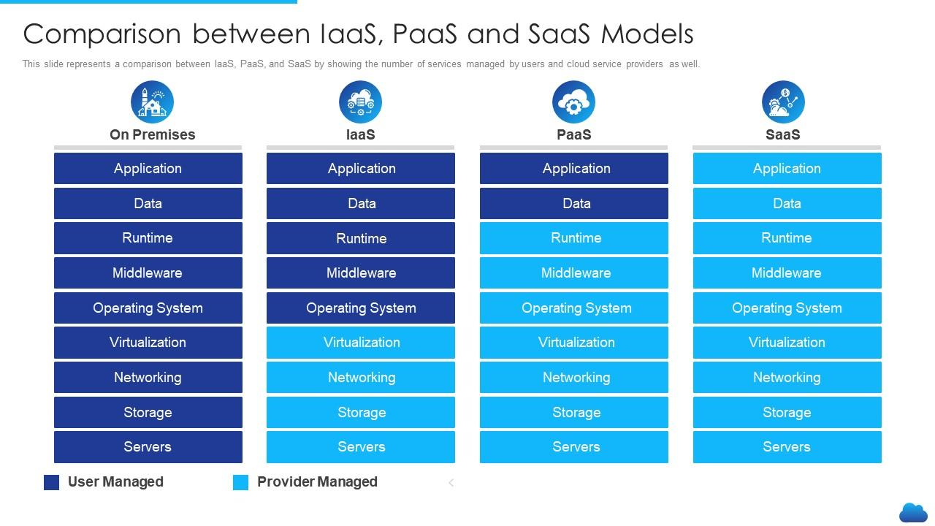

Slide 17
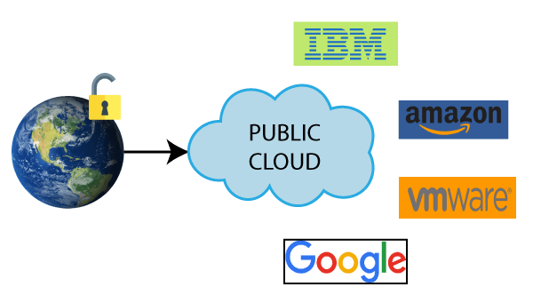
Public CLOUD
Public cloud is highly scalable as per the requirement of computing resources.
It is accessible by the general public, so there is no limit to the number of users.
Public cloud is maintained by the cloud service provider
Public cloud is owned at a lower cost than the private and hybrid cloud.
Disadvantages of Public Cloud
Public Cloud is less secure because resources are shared publicly.
Performance depends upon the high-speed internet network link to the cloud provider.
Example: Amazon elastic compute cloud (EC2), IBM SmartCloud Enterprise, Microsoft, Google App Engine, Windows Azure Services Platform.

Slide 18
Cloud Providers
Amazon Web Services (AWS)
Microsoft Azure
Google Cloud
Alibaba Cloud
IBM Cloud
Oracle
Salesforce
SAP
Rackspace Cloud
VMWare

Slide 19
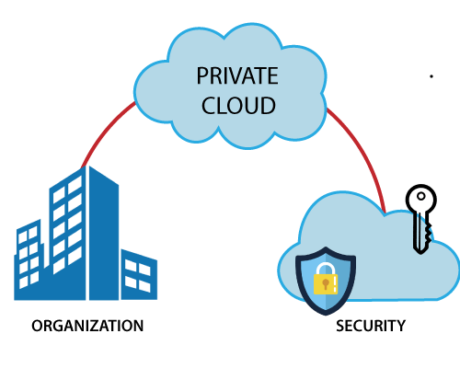
Private Cloud
Private cloud provides a high level of security and privacy to the users.
Private cloud offers better performance with improved speed and space capacity.
It allows the IT team to quickly allocate and deliver on-demand IT resources.
The organization has full control over the cloud
It is suitable for organizations that require a separate cloud for their personal use and data security is the first priority.
Disadvantages of Private Cloud
Private cloud is accessible within the organization, so the area of operations is limited.
Private cloud is not suitable for organizations that have a high user base
Example: HP Data Centers, Microsoft, Elastra-private cloud

Slide 20
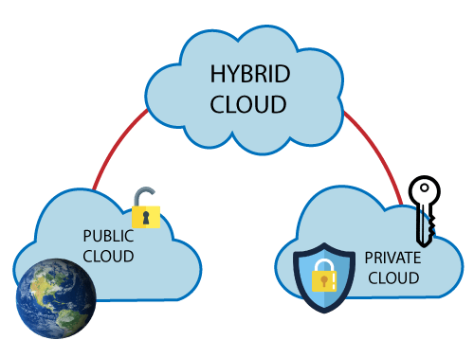
Hybrid cLOud
Hybrid cloud = public cloud + private cloud
In the Hybrid cloud, non-critical activities are performed by the public cloud and critical activities are performed by the private cloud.
Mainly, a hybrid cloud is used in finance, healthcare, and Universities.
Hybrid cloud costs less than the private cloud. It helps organizations to save costs for both infrastructure and application support.
Hybrid cloud provides an excellent way for companies to manage the risk.
Hybrid cloud helps you to deliver new products and services more quickly.
Disadvantages
Managing a hybrid cloud is complex because it is difficult to manage more than one type of deployment model.
In the hybrid cloud, the reliability of the services depends on cloud service providers.
Example: Google Application Suite (Gmail, Google Apps, and Google Drive), Office 365 (MS Office on the Web and One Drive), Amazon Web Services.

Slide 21
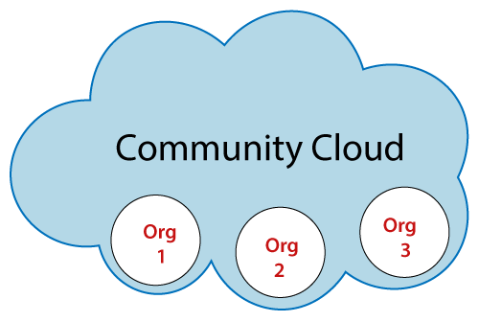
Community Cloud
Advantages
It provides better security than the public cloud.
It provides collaborative and distributive environment.
Community cloud allows us to share cloud resources, infrastructure, and other capabilities among various organizations.
Disadvantages
The fixed amount of data storage and bandwidth is shared among all community members.
Community Cloud is costly than the public cloud.
Sharing responsibilities among organizations is difficult.
Example: Health Care community cloud

Slide 22
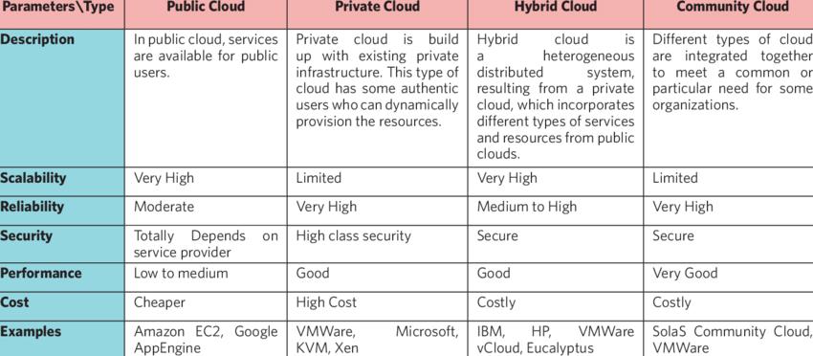
Types Of CLOUD

Slide 23
Key challenges in Cloud environments
1. Data Security and Privacy
2. Cost Management
3. Performance Challenges
4. Interoperability and Flexibility
5. High Dependence on Network
6. Lack of Knowledge and Expertise

Slide 24
Automation possibilities in cloud platform,
AWS CloudFormation: this tool mechanizes and sends resources into your AWS cloud infrastructure.
Terraform : Terraform is an open source tool by Hashicorp, which lets you build, modify and version Infrastructure as Code.
Puppet: Helps configure, model, and authorize infrastructure configurations. Works for all cloud variations, from computing to storage and further to systems networking resources at a large scale.
Kubernetes: A holder organization apparatus is known for scaling, automating deployment, and the management of compartment applications.
Ansible: Ansible is another configuration management product that is synonymous with IaC, developed by Red Hat
AWS Elastic Beanstalk: Elastic Beanstalk is an automation platform that lets you deploy applications developed with Java, .NET, PHP, Node.js, Python, Ruby, Go, and Docker, across EC2 instances

Slide 25
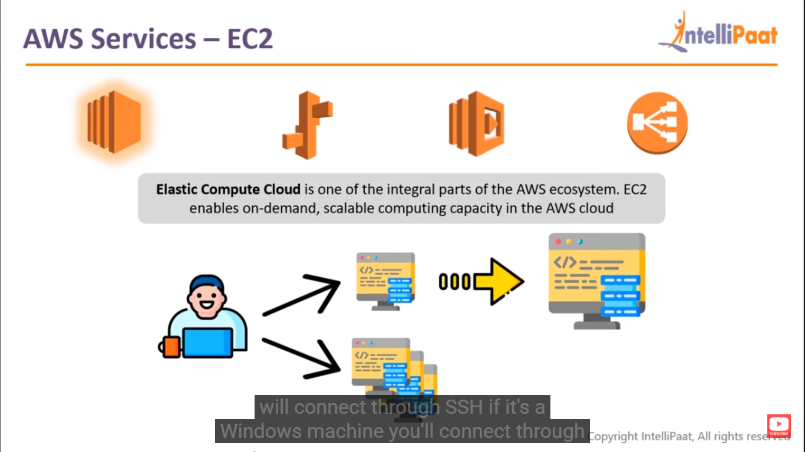
AWS Services = EC2

Slide 26
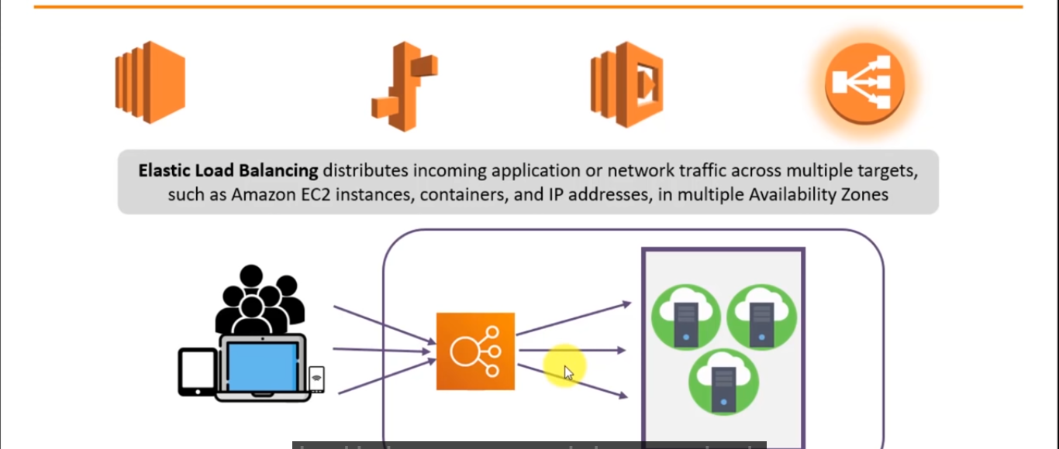
AWS Services – Elastic Load Balancing

Slide 27
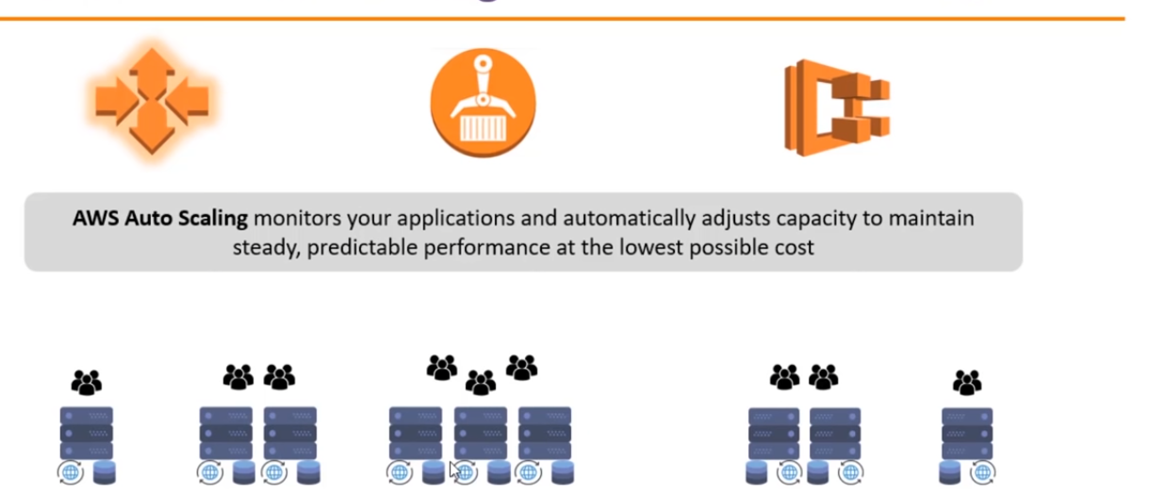
Aws Services – Auto Scaling

Slide 28
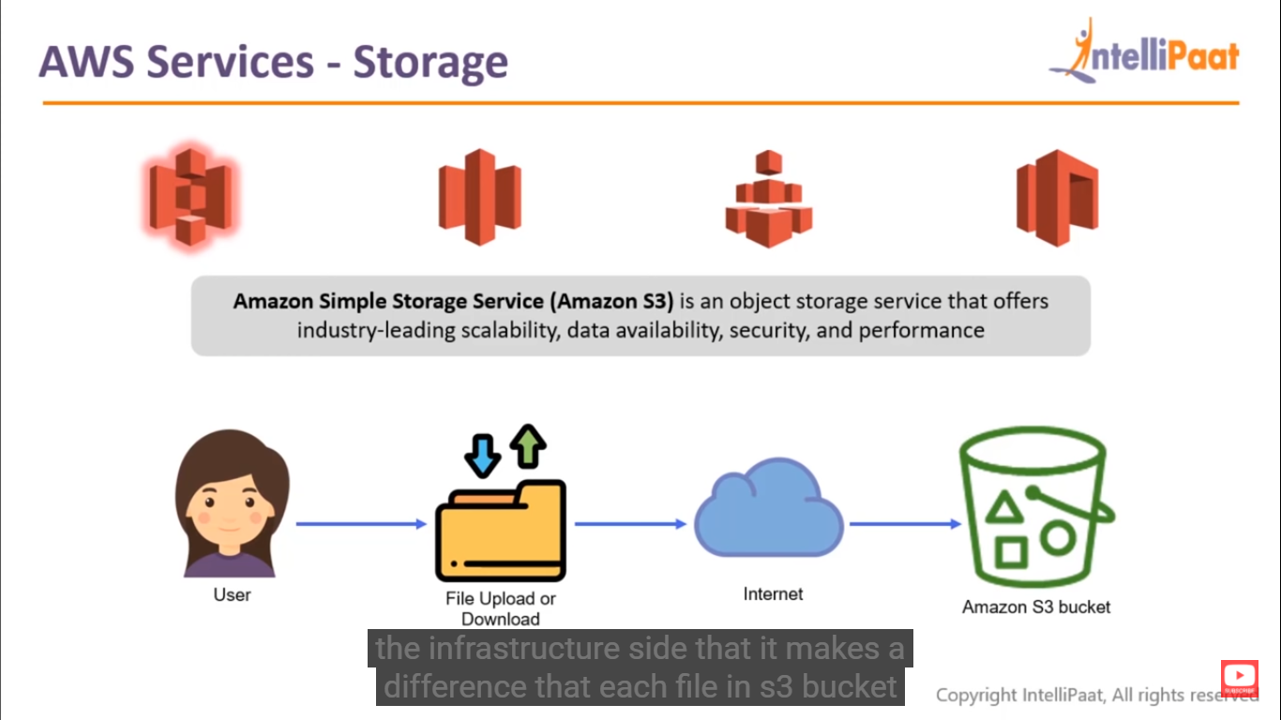
AWS services - Storage

Slide 29
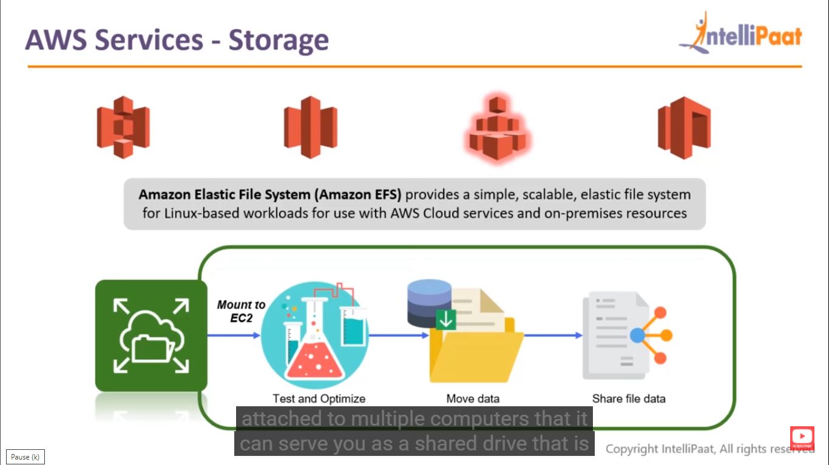
Aws Services -Storage

Slide 30
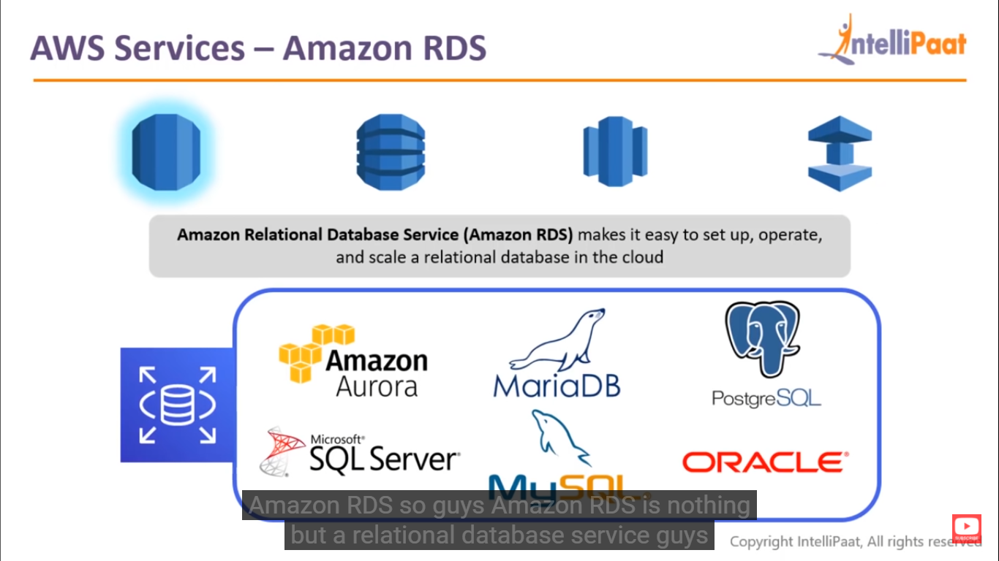
AWS services – Amazon RDS

Slide 31
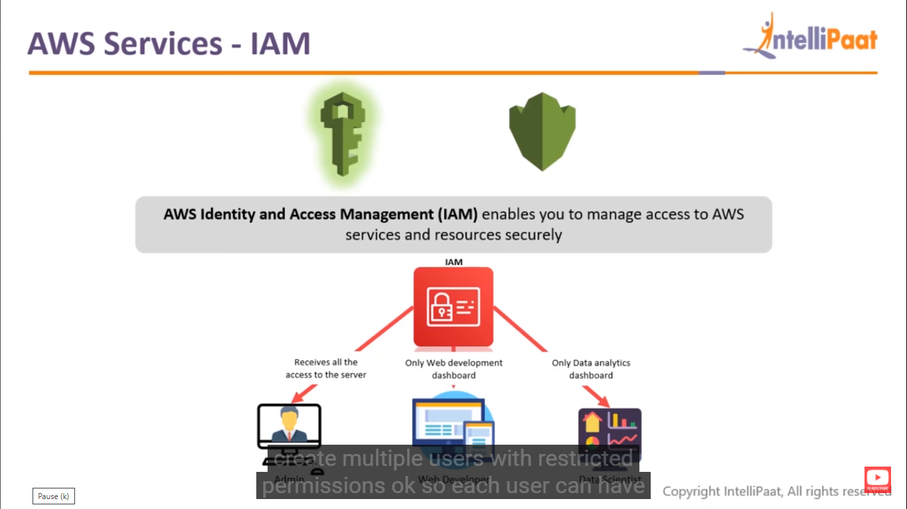
AWS Services - IAM

Slide 32
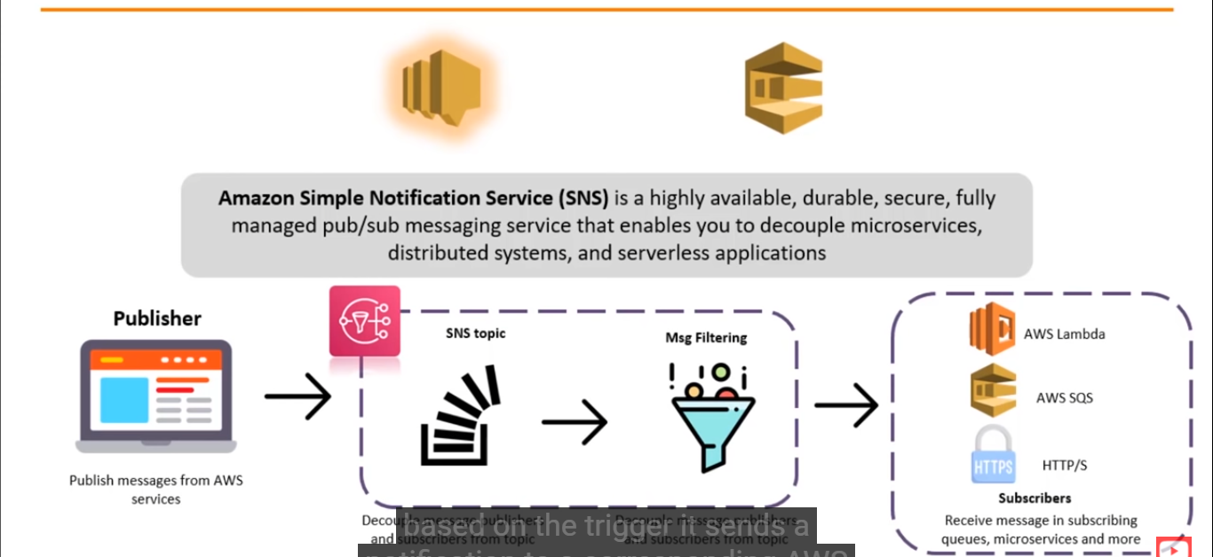
AWS Services – Simple Notification Service

Slide 33
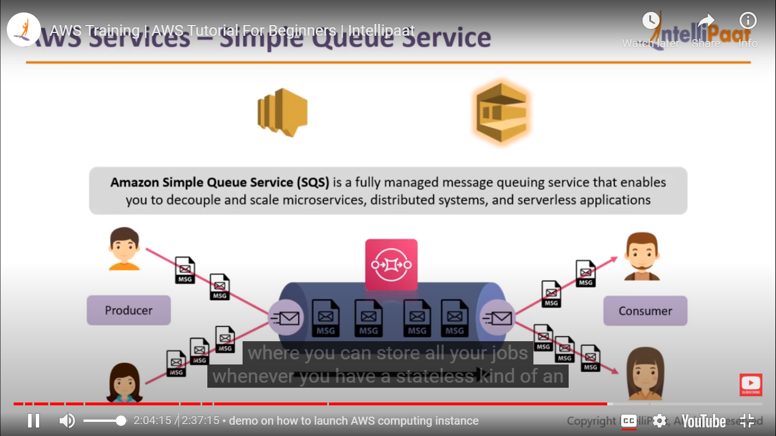
Aws Services – Simple Queue Service

Slide 34
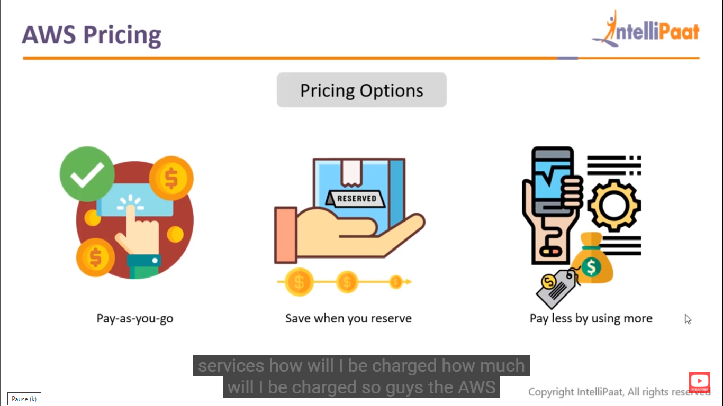
AWS Pricing

Slide 35
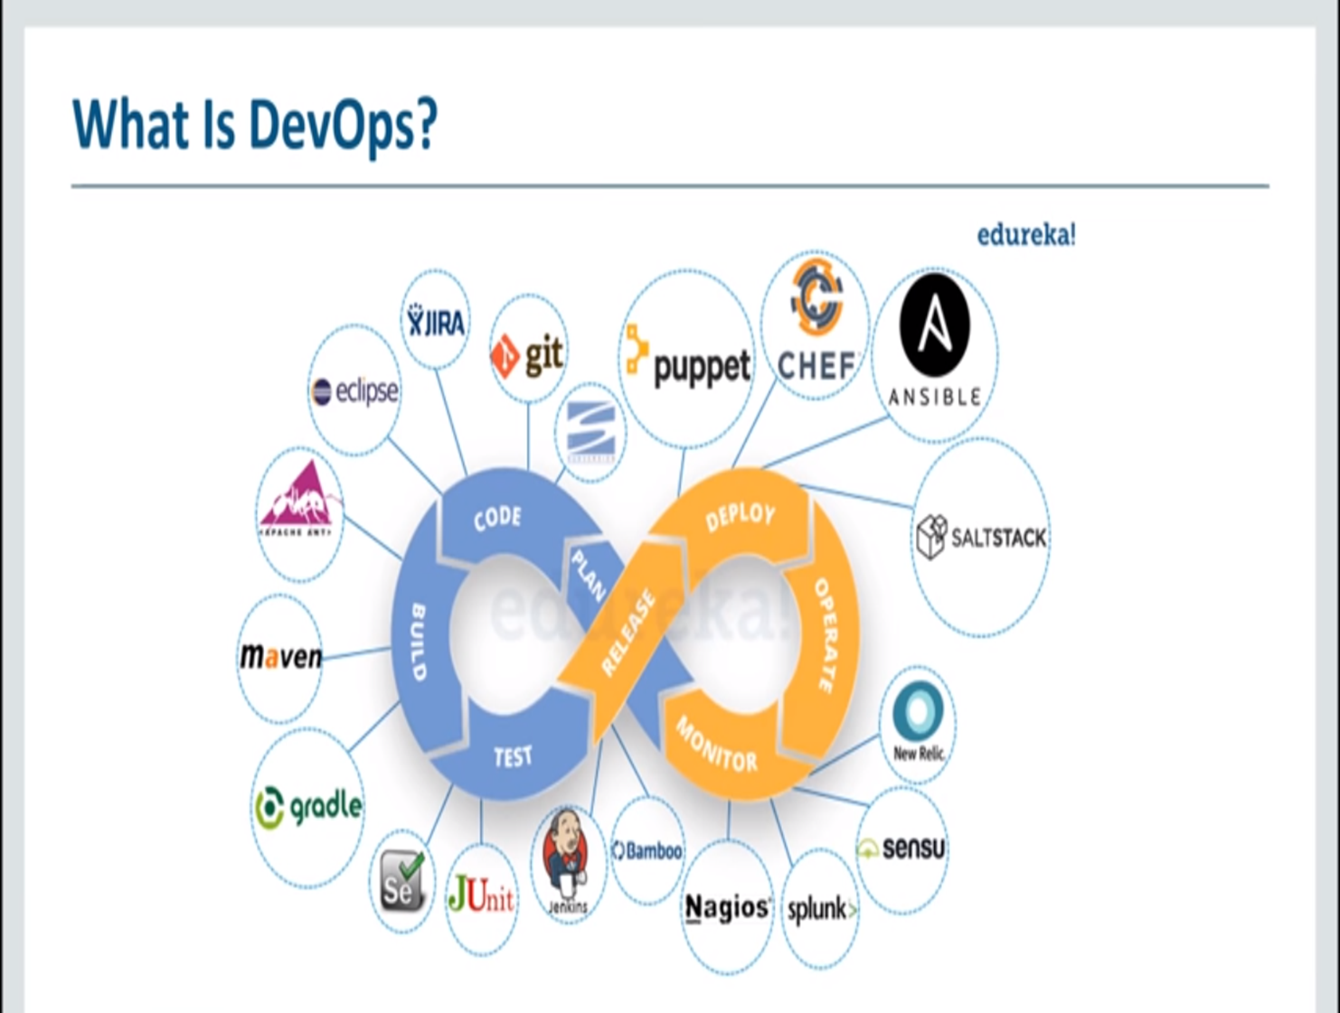

Slide 36
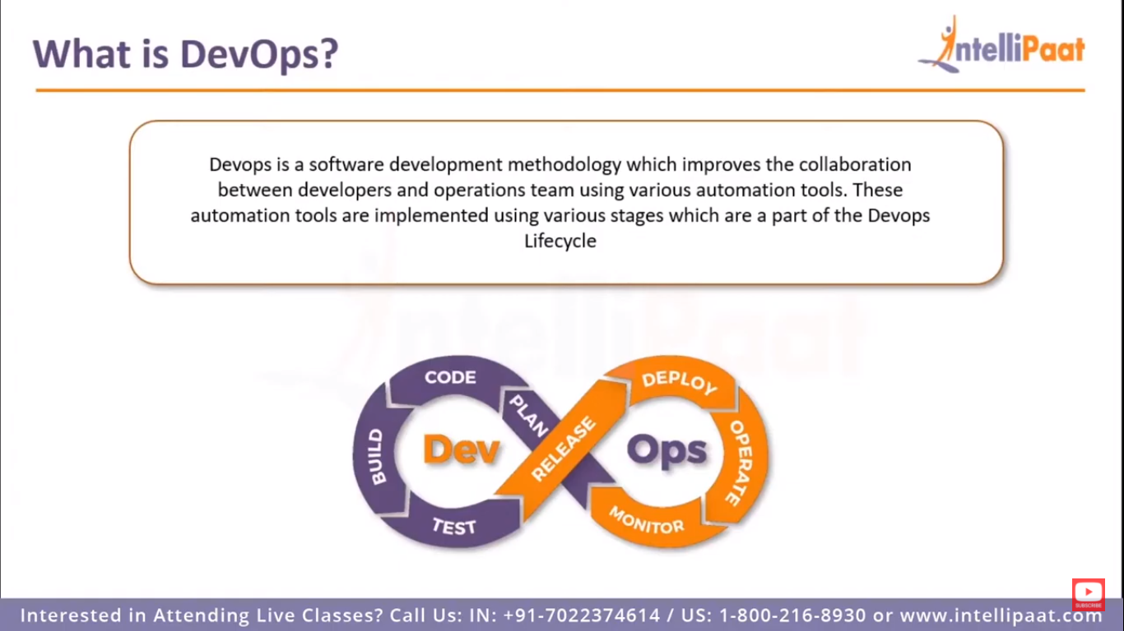

Slide 37
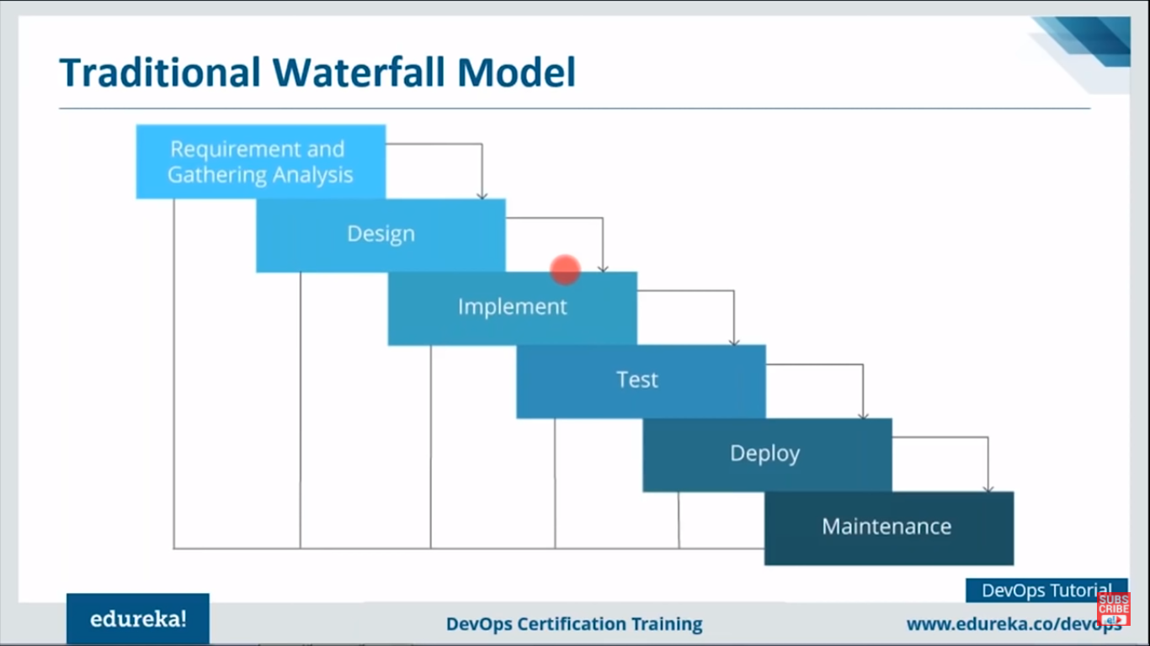

Slide 38
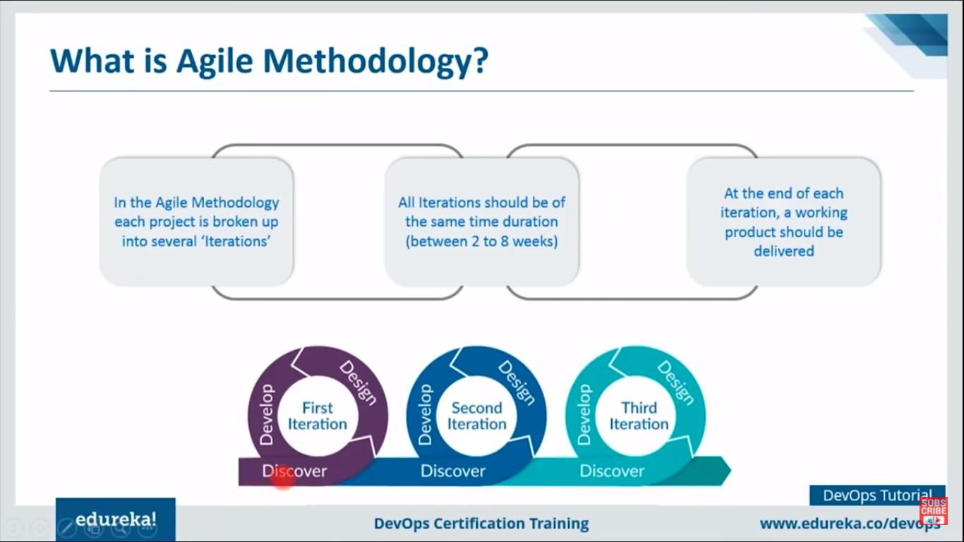

Slide 39
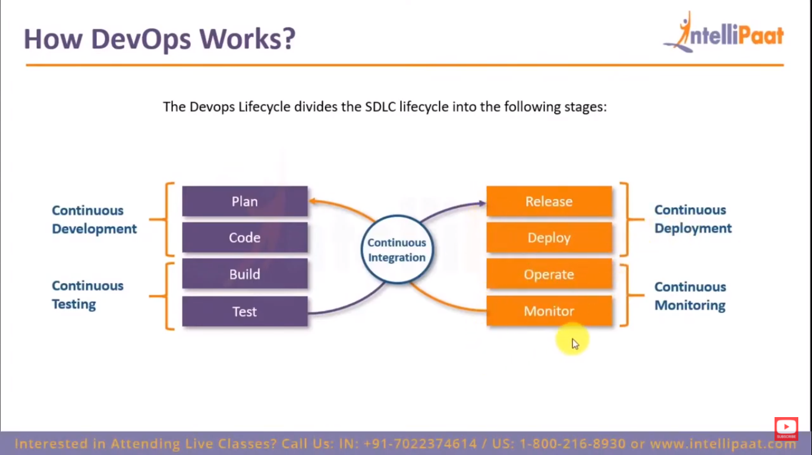

Slide 40
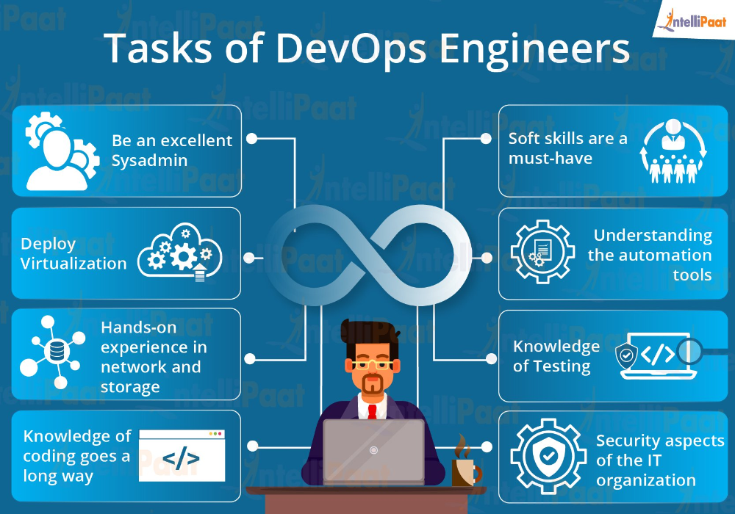

Slide 41
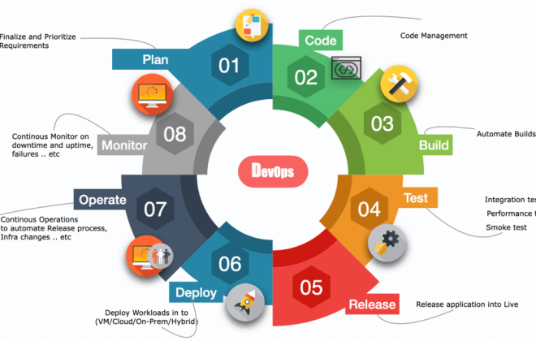
DevOps Lifecycle & Work Flow

Slide 42
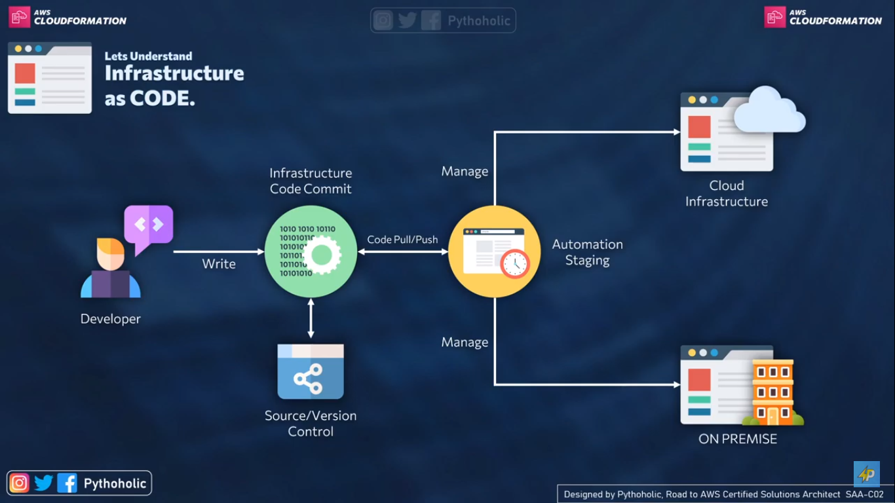
Infrasturcture as CODE

Slide 43
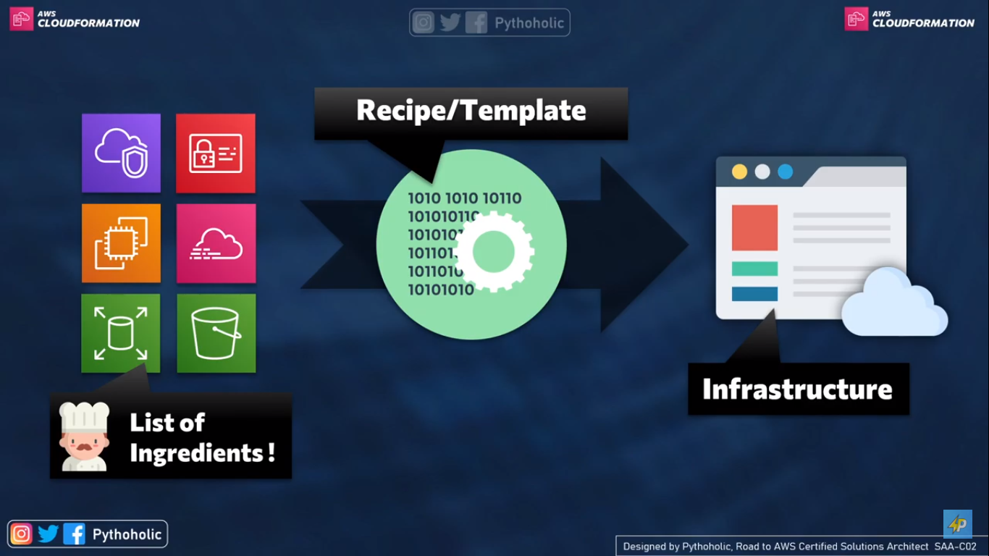
Working

Slide 44
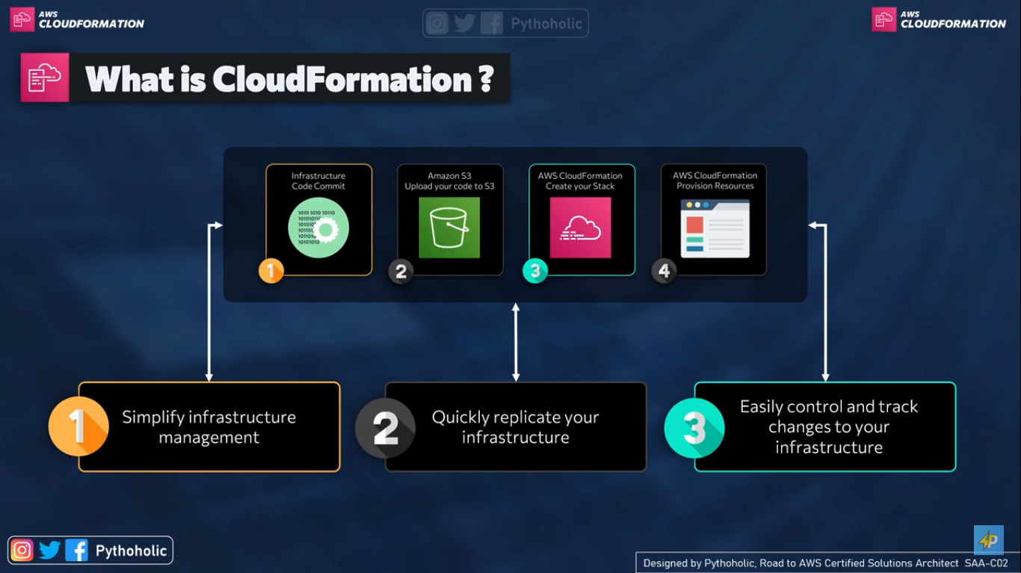

Slide 45
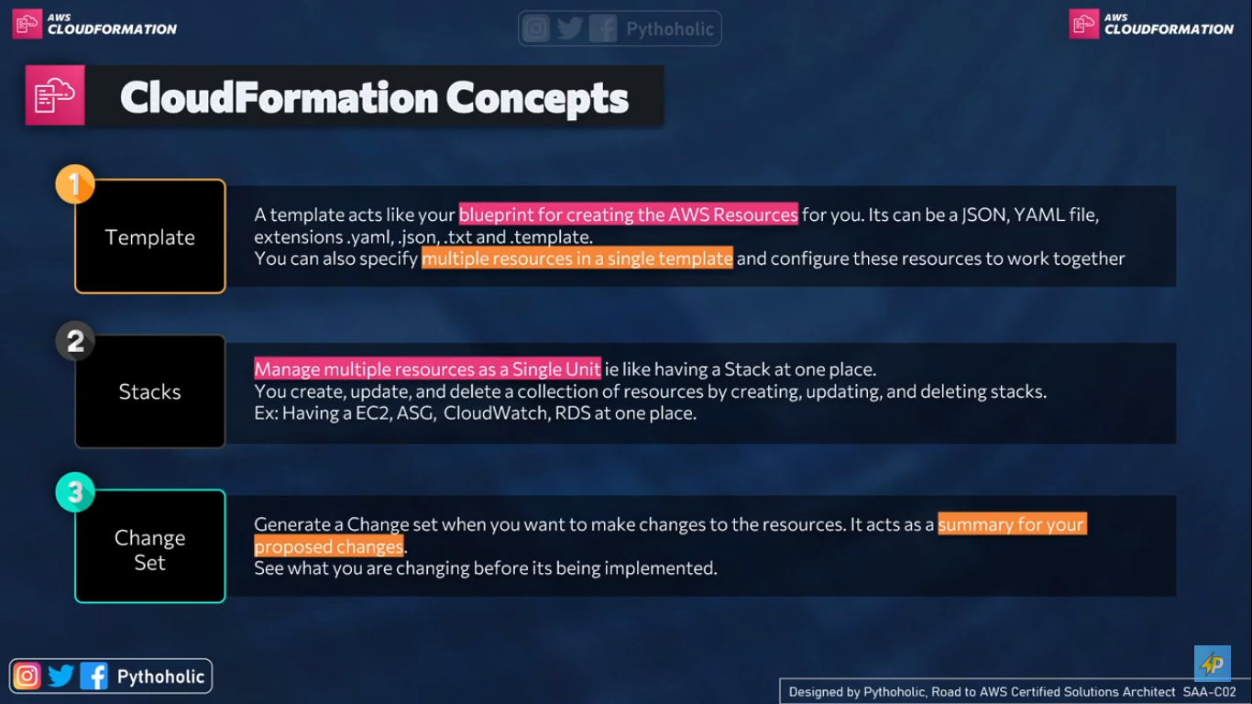

Slide 46
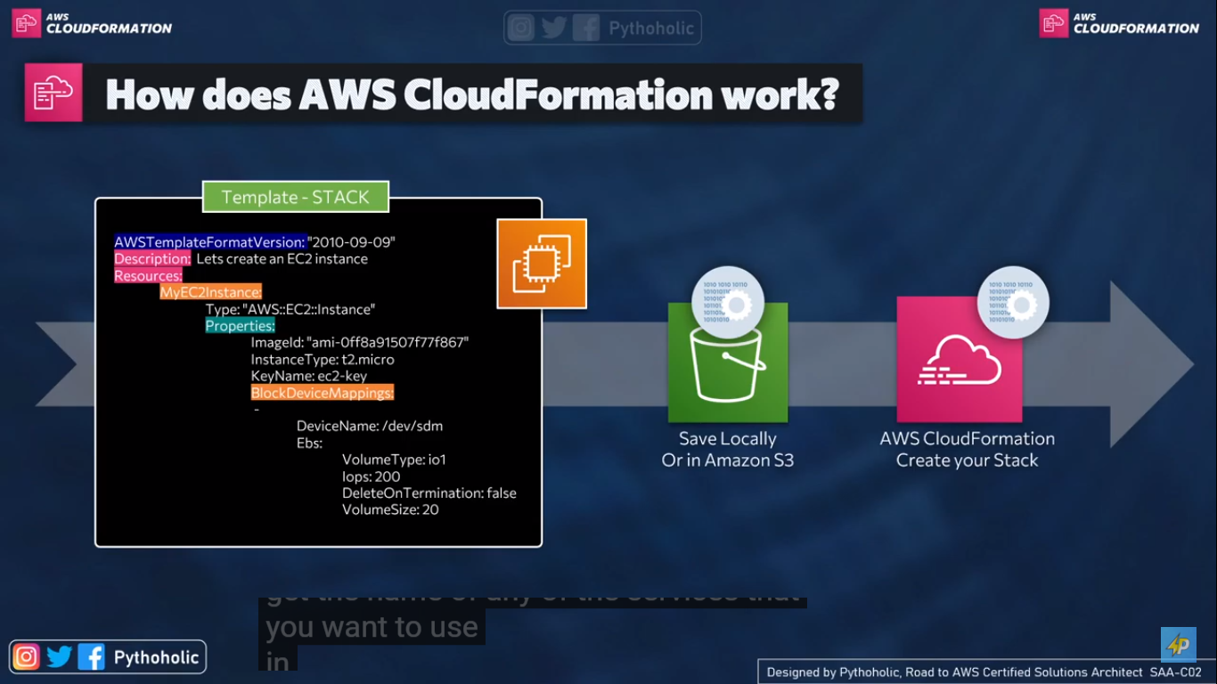

Slide 47
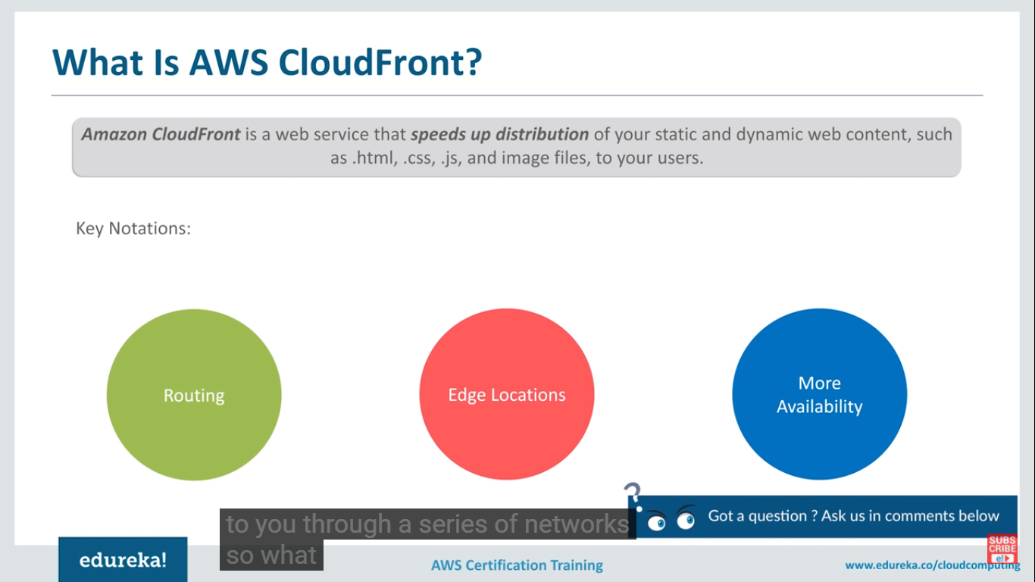

Slide 48
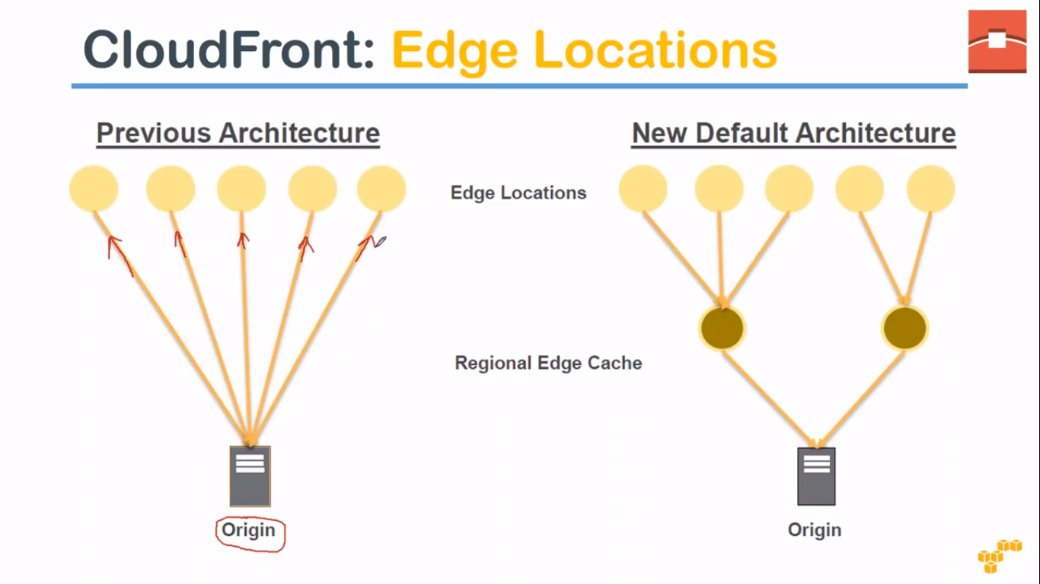

Slide 49
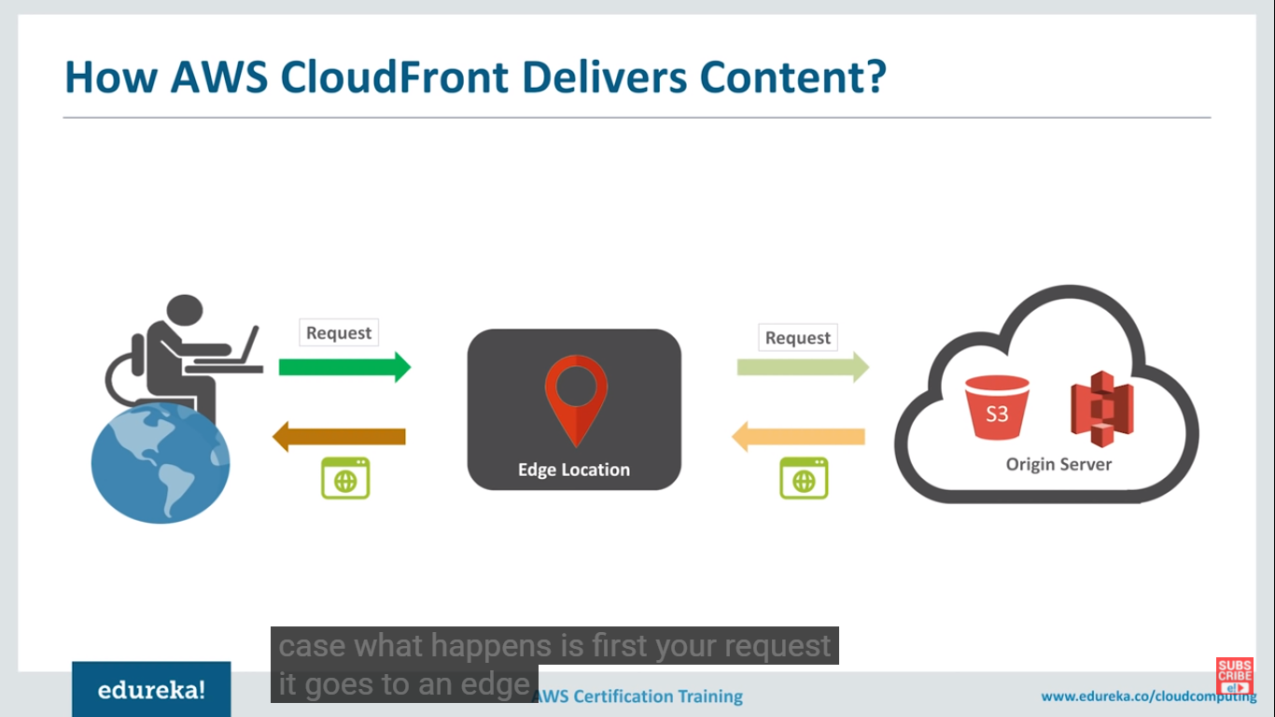

Slide 50
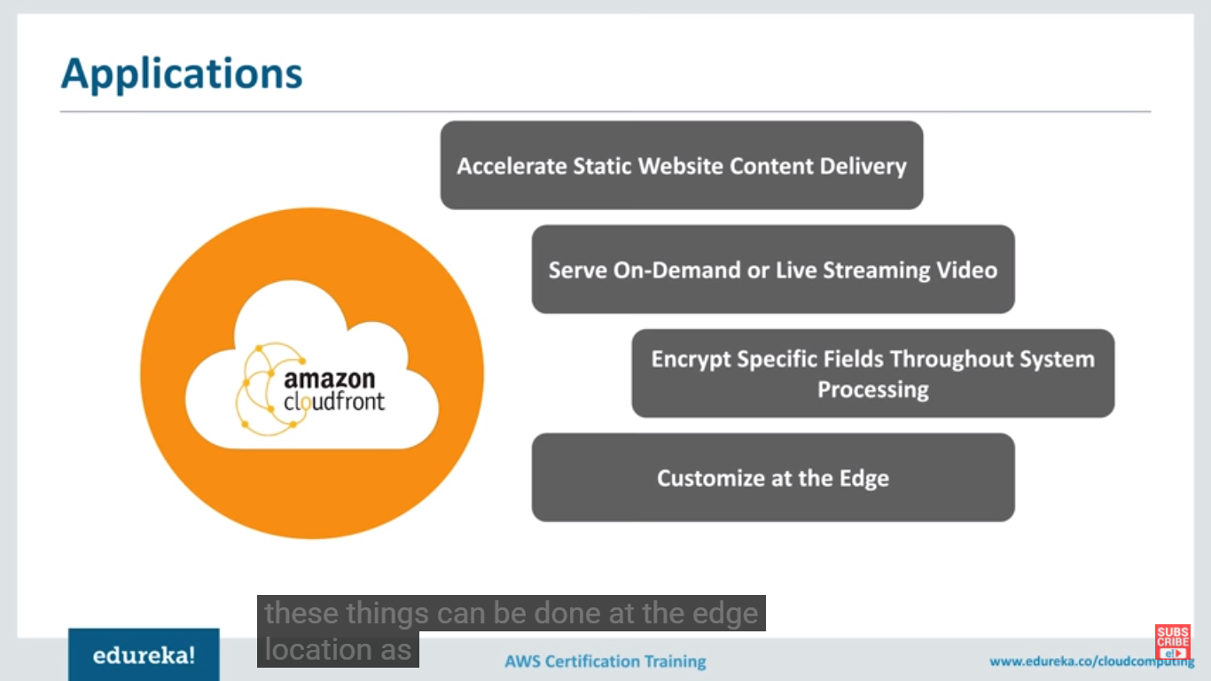

Slide 51
Edge location-we don’t have to configure any server, it stores the popular responses .it will remain for 24 hrs by default.
Regional edge location- Amazon has added several regional edge location.
Cache is bit larger
Reduce the burden of origin
Parity with edge location- a cache invalidation request removes object from edge & regional locations
Whenever user tries to access data from specific country, he will be automatically routed to nearest edge location server.
Low latency with best possible performance

Slide 52
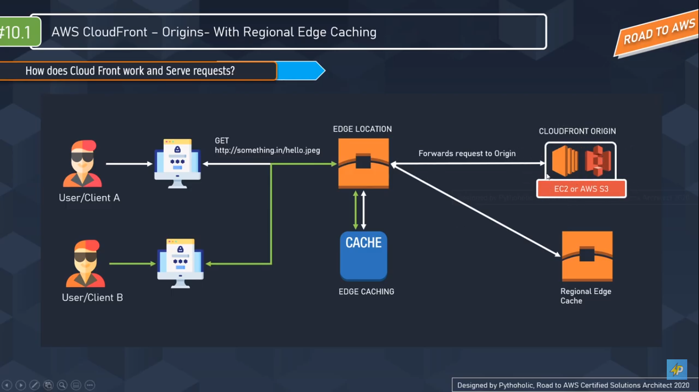

Slide 53
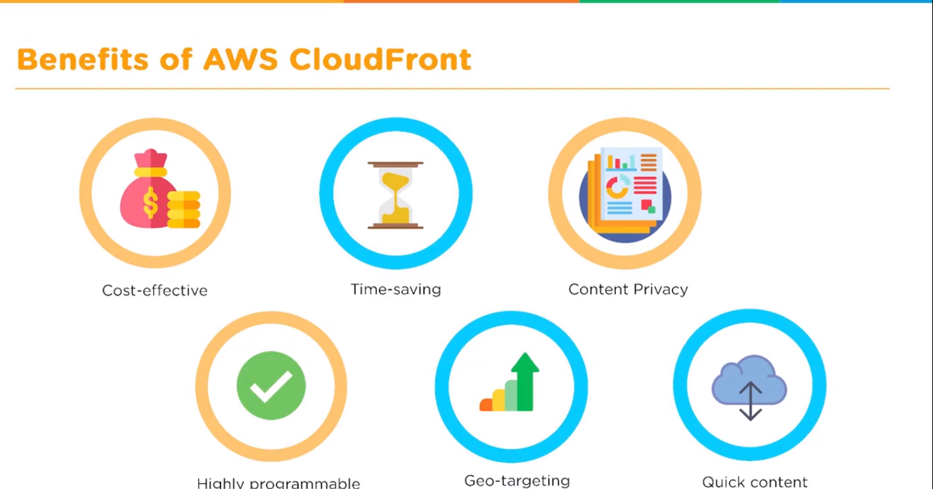

Slide 54
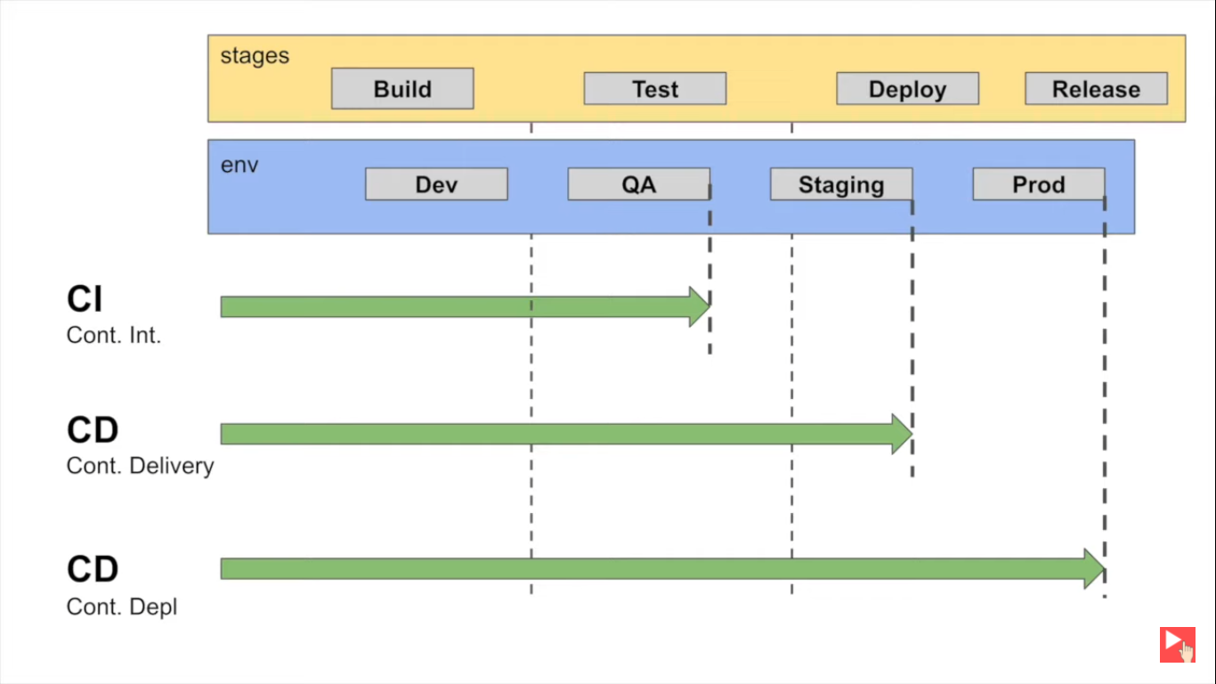

Slide 55
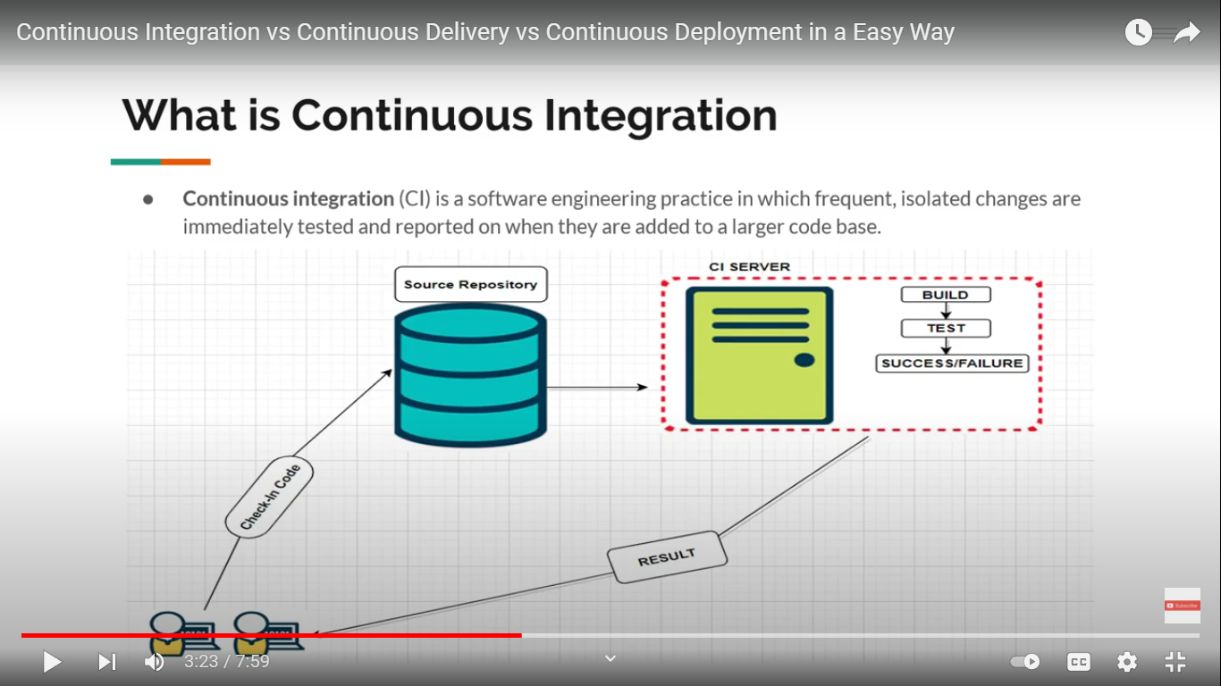

Slide 56
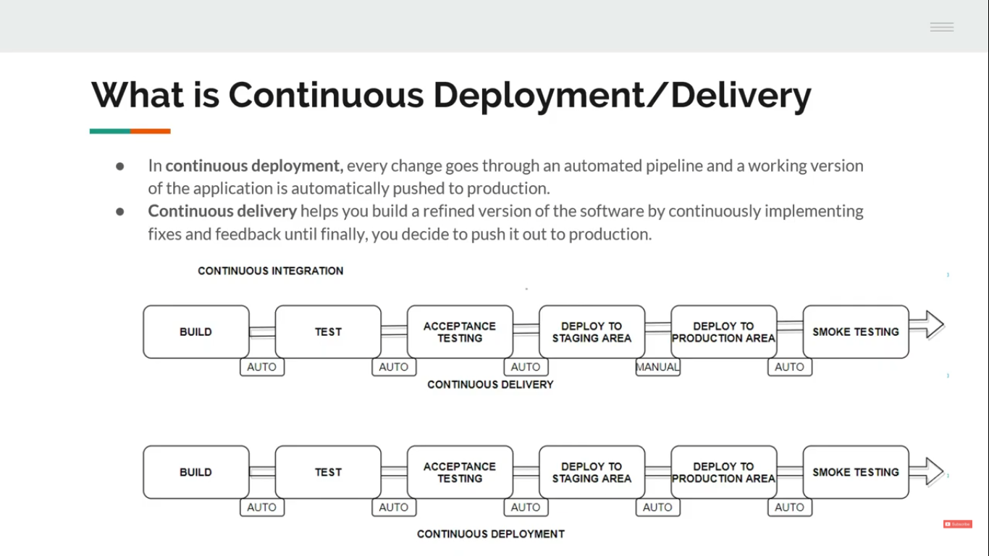

Slide 57
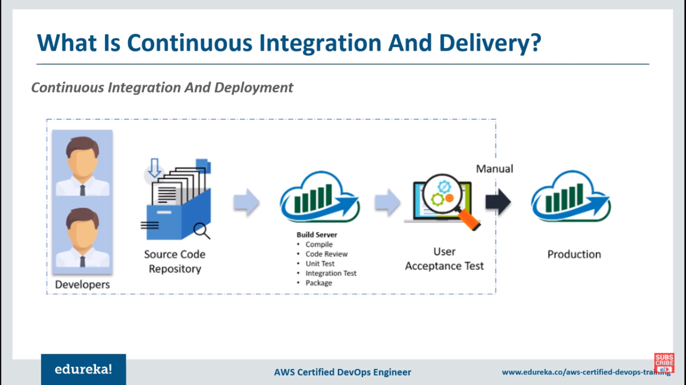

Slide 58
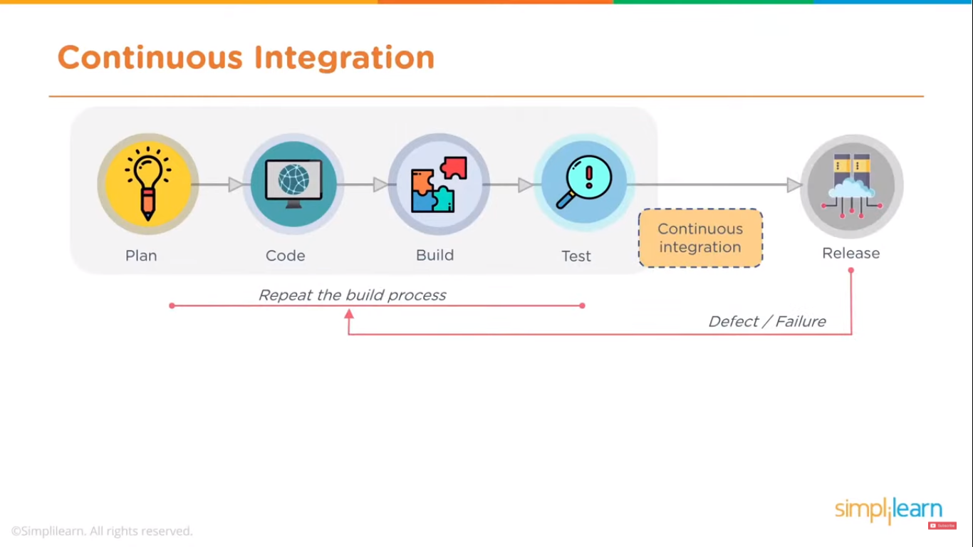

Slide 59
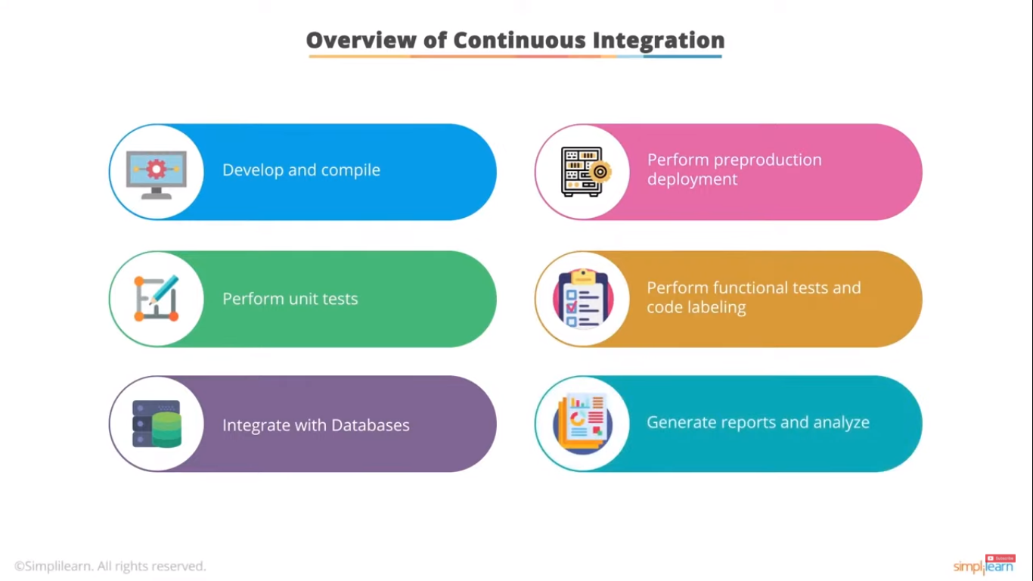

Slide 60
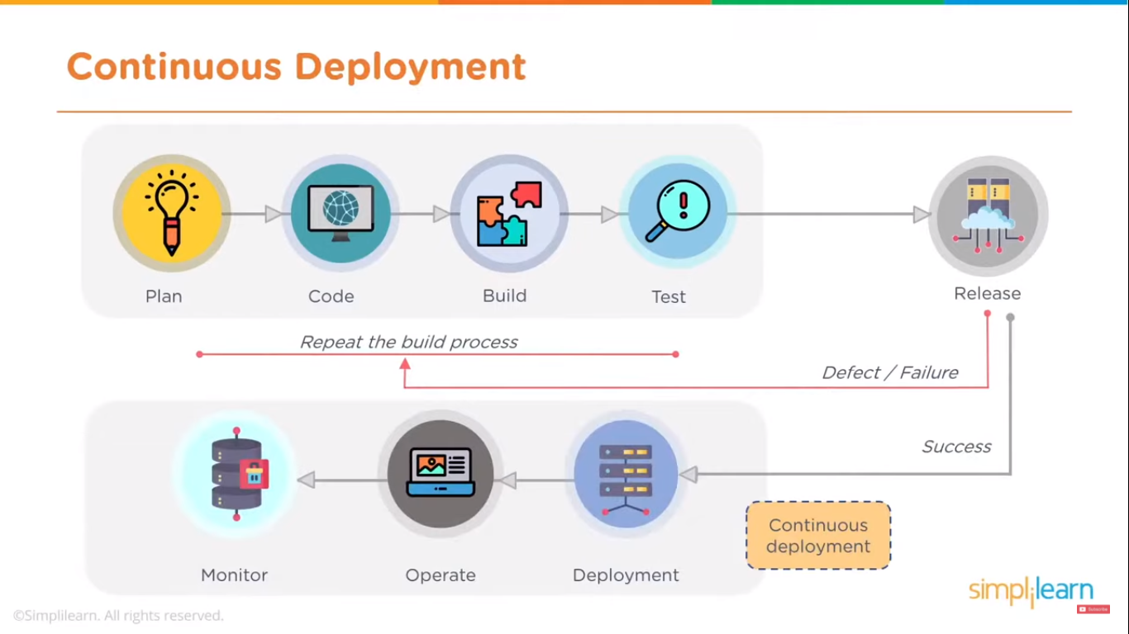

Slide 61



Slide 62


Slide 63


Slide 64


Slide 65


Slide 66


Slide 67


